Slide 1
Summation and Series

Slide 2
Reading
zyBook:
Chapter 15.1, 15.3

Slide 3

Summation/Product Notation
$$\sum_{i=0}^{n}{ic}$$
$$\prod_{i=0}^{n}{ic}$$

Slide 4
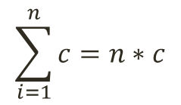
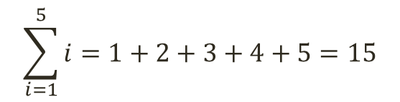
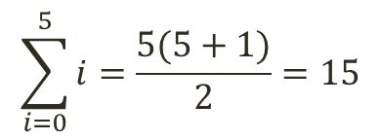
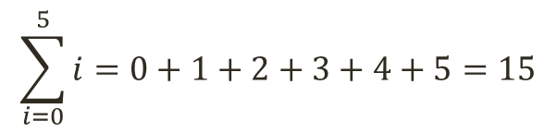
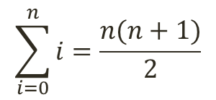
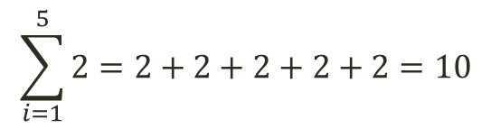
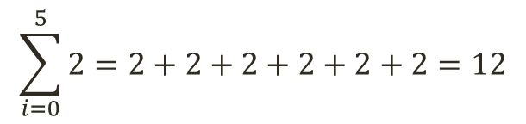
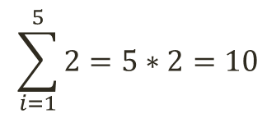
Series and Summation 1/3
$$\sum_{i=0}^{5}{i}=0+1+2+3+4+5=15$$
$$\sum_{i=0}^{5}{2}=2+2+2+2+2+2=12$$
$$\sum_{i=1}^{5}{i}=1+2+3+4+5=15$$
$$\sum_{i=1}^{5}{2}=2+2+2+2+2=10$$
$$\sum_{i=0}^{n}{i}=\frac{n(n+1)}{2}$$
$$\sum_{i=0}^{5}{i}=\frac{5(5+1)}{2}=15$$
$$\sum_{i=1}^{n}{c}=n∗c$$
$$\sum_{i=1}^{5}{2}=5∗2=10$$

Slide 5
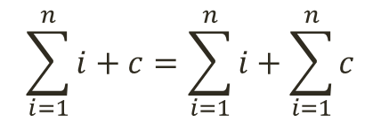
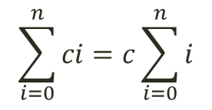
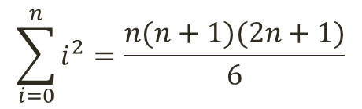
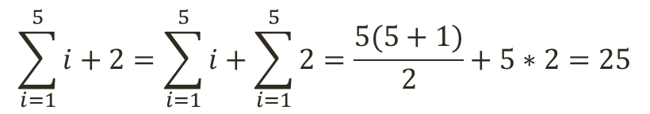
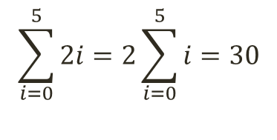
Series and Summation 2/3
$$\sum_{i=0}^{n}{ci}=c\sum_{i=0}^{n}{i}$$
$$\sum_{i=0}^{5}{2i}=2\sum_{i=0}^{5}{i}=30$$
$$\sum_{i=1}^{n}{i+c}=\sum_{i=1}^{n}{i}+\sum_{i=1}^{n}{c}$$
$$\sum_{i=1}^{5}{i+2}=\sum_{i=1}^{5}{i}+\sum_{i=1}^{5}{2}=\frac{5(5+1)}{2}+5∗2=25$$
$$\sum_{i=0}^{n}{i^{2}}=\frac{n(n+1)(2n+1)}{6}$$

Slide 6
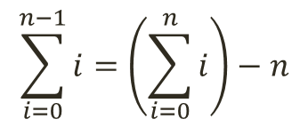
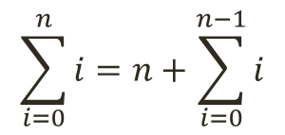
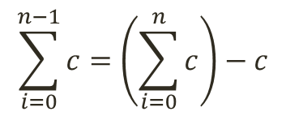
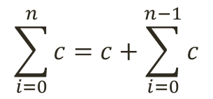
Series and Summation 3/3
$$\sum_{i=0}^{n}{i}=n+\sum_{i=0}^{n−1}{i}$$
$$\sum_{i=0}^{n−1}{i}=\left(\sum_{i=0}^{n}{i}\right)−n$$
$$\sum_{i=0}^{n}{c}=c+\sum_{i=0}^{n−1}{c}$$
$$\sum_{i=0}^{n−1}{c}=\left(\sum_{i=0}^{n}{c}\right)−c$$

Slide 7
Analysis of Algorithms
Compare algorithms
Time Complexity
For one run
For many runs
Space Complexity

Slide 8
Basic Instructions
x = 5
1 instruction
2 + 3
1 instruction
x < y
1 instruction
int x
1 instruction
x += 5
1 instruction
Wait...

Slide 9

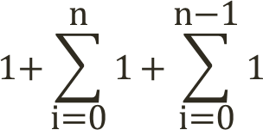
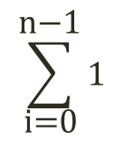
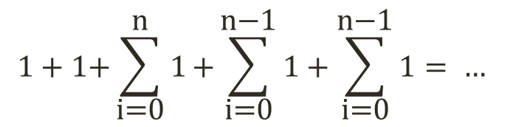
Summation
void sum1D(int arr[], int n)
{
int sum = 0;
for(int i = 0; i < n; i++){
sum += arr[i];
}
}
$$1+1\text{+}\sum_{\text{i}\text{=0}}^{\text{n}}{\text{1}}\text{+}\sum_{\text{i}\text{=0}}^{\text{n}\text{−1}}{\text{1}}+\sum_{\text{i}\text{=0}}^{\text{n}\text{−1}}{\text{1}}= …$$

Slide 10
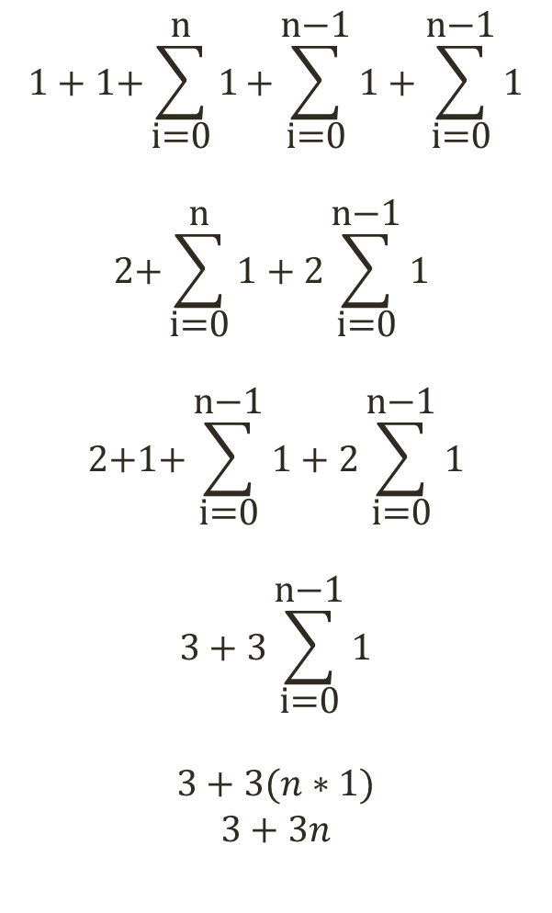
Cleanup
$$1+1\text{+}\sum_{\text{i}\text{=0}}^{\text{n}}{\text{1}}\text{+}\sum_{\text{i}\text{=0}}^{\text{n}\text{−1}}{\text{1}}+\sum_{\text{i}\text{=0}}^{\text{n}\text{−1}}{\text{1}}$$
$$2\text{+}\sum_{\text{i}\text{=0}}^{\text{n}}{\text{1}}+2\sum_{\text{i}\text{=0}}^{\text{n}\text{−1}}{\text{1}}$$
$$2\text{+}\text{1+}\sum_{\text{i}\text{=0}}^{\text{n}\text{−1}}{\text{1}}+2\sum_{\text{i}\text{=0}}^{\text{n}\text{−1}}{\text{1}}$$
$$3+3\sum_{\text{i}\text{=0}}^{\text{n}\text{−1}}{\text{1}}$$
$$3+3(n∗1)$$
$$3+3n$$

Slide 11
Summation
void sum1D(int arr[], int n)
{
int sum = 0;
for(int i = 0; i < n; i++){
sum += arr[i];
}
}
1
1 + 1*(n+1) + 1*n
1*n
1 + 1 + 1*(n+1) + 1*n + 1*n = 3n+3

Slide 12
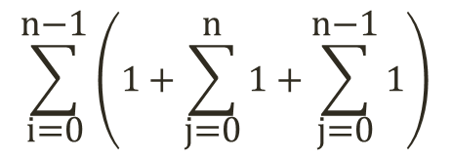
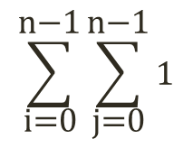
Summing
void sum2D(int arr[][], int n)
{
int sum = 0;
for(int i = 0; i < n; i++){
for(int j = 0; j < n; j++){
sum += arr[i][j];
}
}
}
1

Slide 13
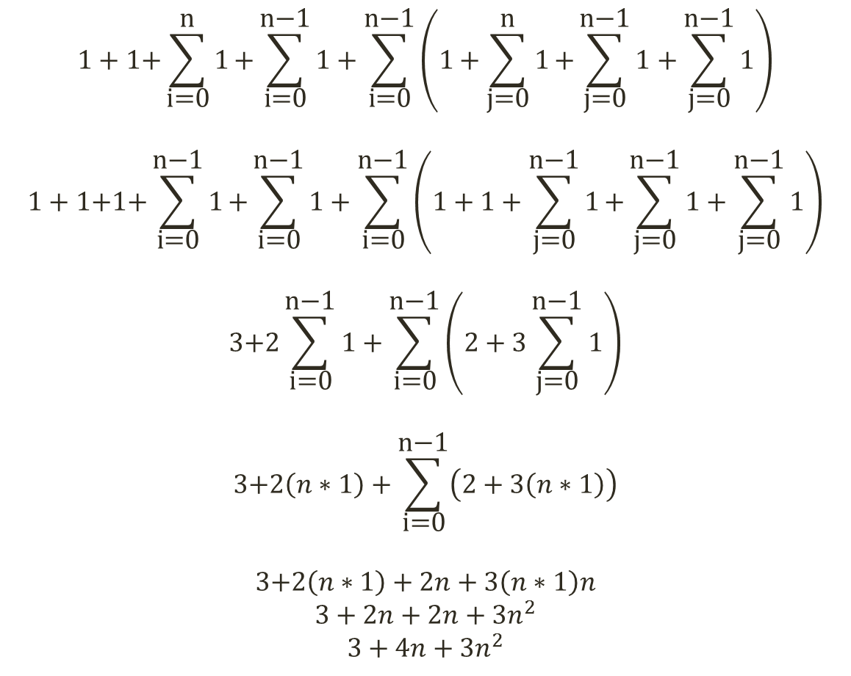
Cleanup
$$1+1\text{+}\sum_{\text{i}\text{=0}}^{\text{n}}{\text{1}}\text{+}\sum_{\text{i}\text{=0}}^{\text{n}\text{−1}}{\text{1}}+\sum_{\text{i}\text{=0}}^{\text{n}\text{−1}}{\left(1+\sum_{\text{j}\text{=0}}^{\text{n}}{\text{1}}\text{+}\sum_{\text{j}\text{=0}}^{\text{n}\text{−1}}{\text{1}}+\sum_{\text{j}\text{=0}}^{\text{n}\text{−1}}{\text{1}}\right)}$$
$$1+1\text{+}\text{1+}\sum_{\text{i}\text{=0}}^{\text{n}\text{−1}}{\text{1}}\text{+}\sum_{\text{i}\text{=0}}^{\text{n}\text{−1}}{\text{1}}+\sum_{\text{i}\text{=0}}^{\text{n}\text{−1}}{\left(1+1+\sum_{\text{j}\text{=0}}^{\text{n}\text{−}\text{1}}{\text{1}}\text{+}\sum_{\text{j}\text{=0}}^{\text{n}\text{−1}}{\text{1}}+\sum_{\text{j}\text{=0}}^{\text{n}\text{−1}}{\text{1}}\right)}$$
$$3\text{+}2\sum_{\text{i}\text{=0}}^{\text{n}\text{−1}}{\text{1}}+\sum_{\text{i}\text{=0}}^{\text{n}\text{−1}}{\left(2+3\sum_{\text{j}\text{=0}}^{\text{n}\text{−1}}{\text{1}}\right)}$$
$$3\text{+}2\left(n∗1\right)+\sum_{\text{i}\text{=0}}^{\text{n}\text{−1}}{\left(2+3\left(n∗1\right)\right)}$$
$$3\text{+}2\left(n∗1\right)+2n+3\left(n∗1\right)n$$
$$3+2n+2n+3n^{2}$$
$$3+4n+3n^{2}$$

Slide 14
Summing
void sum2D(int arr[][], int n)
{
int sum = 0;
for(int i = 0; i < n; i++){
for(int j = 0; j < n; j++){
sum += arr[i][j];
}
}
}
1
1 + 1*(n+1) + 1*n
n*(1 + 1*(n+1) + 1*n)
n*n*1
1 + 1 + 1*(n+1) + 1*n + n*(1 + 1*(n+1) + 1*n) + n*n*1 = 3 + 4n + 3n²

Slide 15
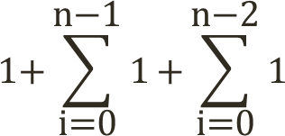
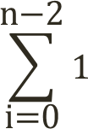
Iterative Factorial
int Factorial(int n){
int product = n;
for(int i=n-1; i>0; i--){
product *= i;
}
return product;
}

Slide 16
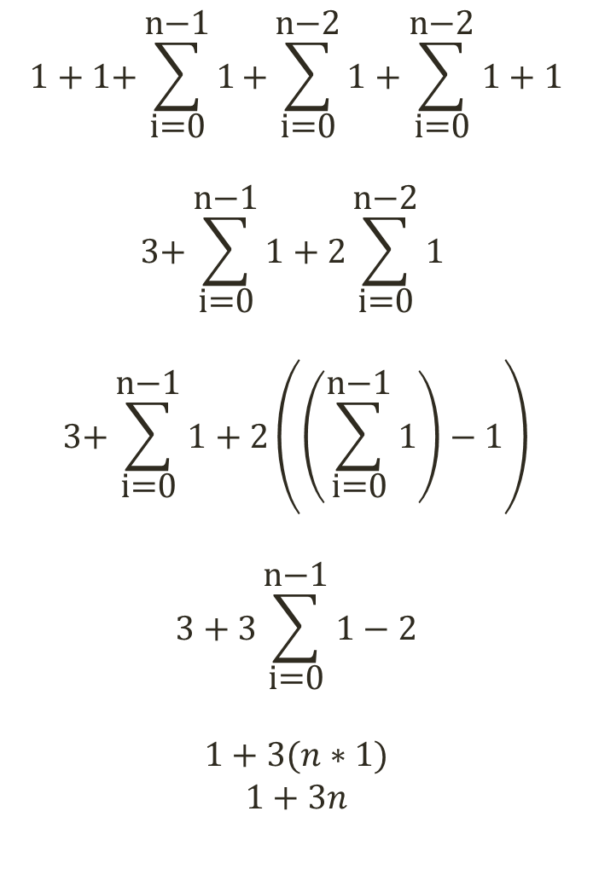
Cleanup
$$1+1\text{+}\sum_{\text{i}\text{=0}}^{\text{n}\text{−}\text{1}}{\text{1}}\text{+}\sum_{\text{i}\text{=0}}^{\text{n}\text{−2}}{\text{1}}+\sum_{\text{i}\text{=0}}^{\text{n}\text{−2}}{\text{1}}+1$$
$$3\text{+}\sum_{\text{i}\text{=0}}^{\text{n}\text{−1}}{\text{1}}+2\sum_{\text{i}\text{=0}}^{\text{n}\text{−2}}{\text{1}}$$
$$3\text{+}\sum_{\text{i}\text{=0}}^{\text{n}\text{−1}}{\text{1}}+2\left(\left(\sum_{\text{i}\text{=0}}^{\text{n}\text{−1}}{\text{1}}\right)−1\right)$$
$$3+3\sum_{\text{i}\text{=0}}^{\text{n}\text{−1}}{\text{1}}−2$$
$$1+3(n∗1)$$
$$1+3n$$

Slide 17
Iterative Factorial
int Factorial(int n){
int product = n;
for(int i=n-1; i>0; i--){
product *= i;
}
return product;
}
1 + 1*n + 1*(n-1)
1*(n-1)
1 + 1 + 1*n + 1*(n-1) + 1*(n-1) + 1 = 1 + 3n

